Slide 1
Lines and Area
Lines and Area

Slide 2
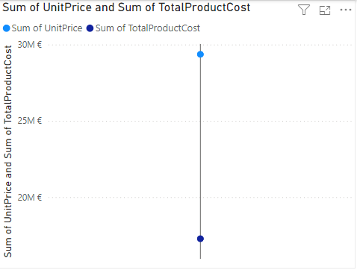
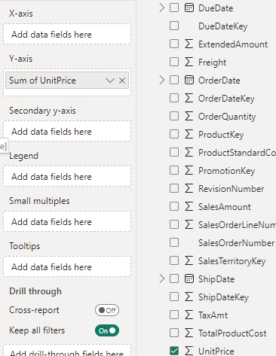
Lines and Areas
Note: This exercise requires the AdventureWorksDW2016 database at the resource level
Add the Line visualization at the scene level and then add UnitPrice and TotalProductCost to the Y-Axis

Slide 3
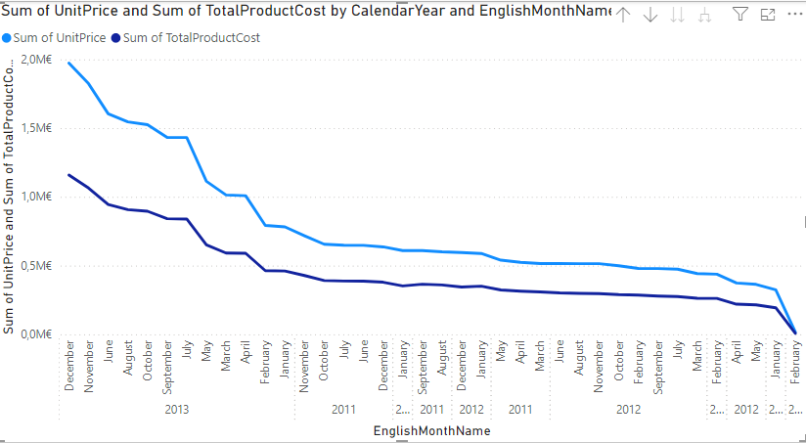
Lines and Areas
And then add CalendarYear and EnglishMonthName to the X-axis

Slide 4
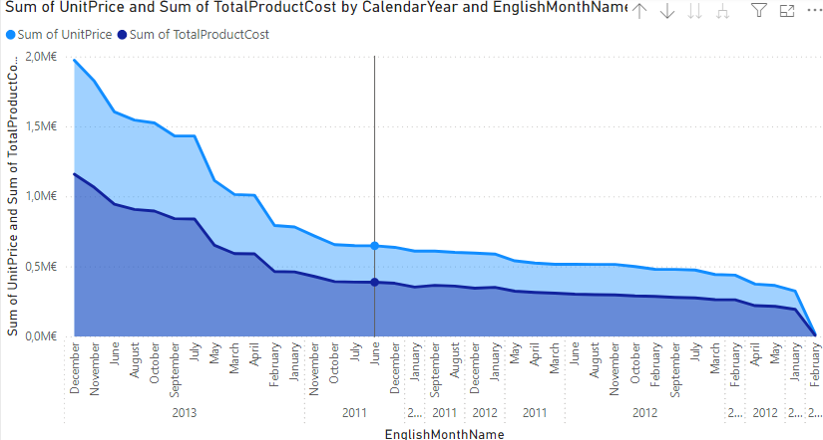
Lines and Areas
Change Visualization to Area

Slide 5
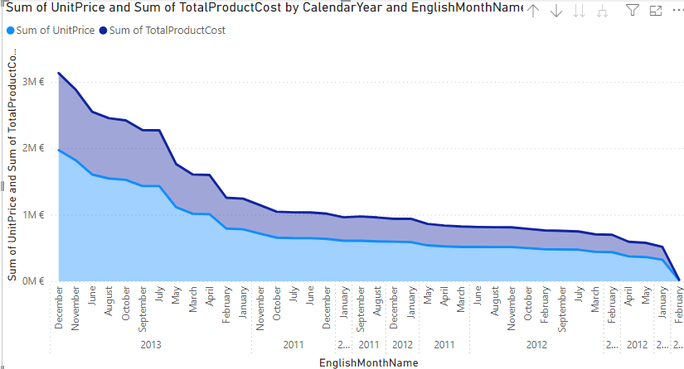
Lines and Areas
Change Visualization to Stacked Area

Slide 6
Lines and Areas
Try to notice the difference between Area and Stacked Area

Slide 7
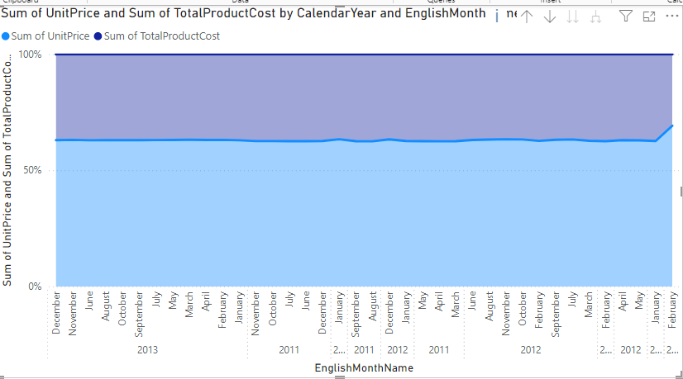
Lines and Areas
Change Visualization to 100% Stacked Area

Slide 8
Thank you
Thank you

